Slide 1
Automated Maintenance System Realization
Kimberly-Clark Tuas Mill
19Jun2023

Slide 2
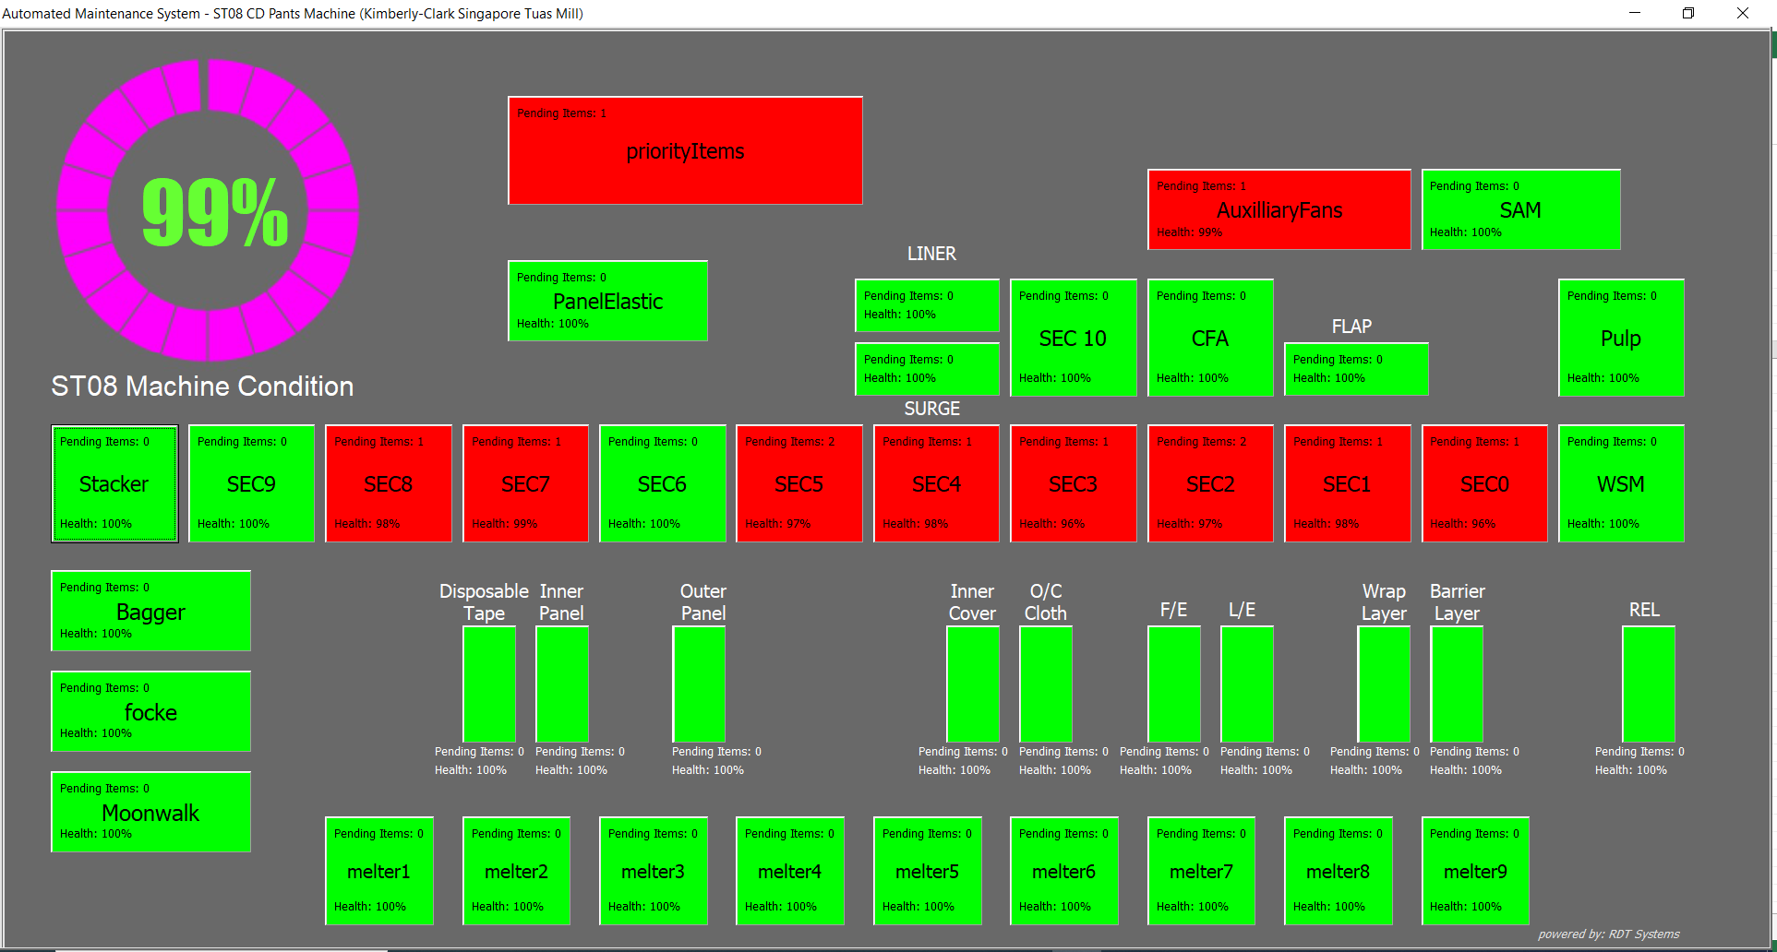
User Interface
Dynamic Visual Info’s:
Overall machine health condition
Pending items per section
Health condition per section
Green buttons means that all items in that particular section are OK
Red button shows that there is a needed maintenance item for a particular section
Interactive Controls:
Buttons, List box, input box, message box

Slide 3


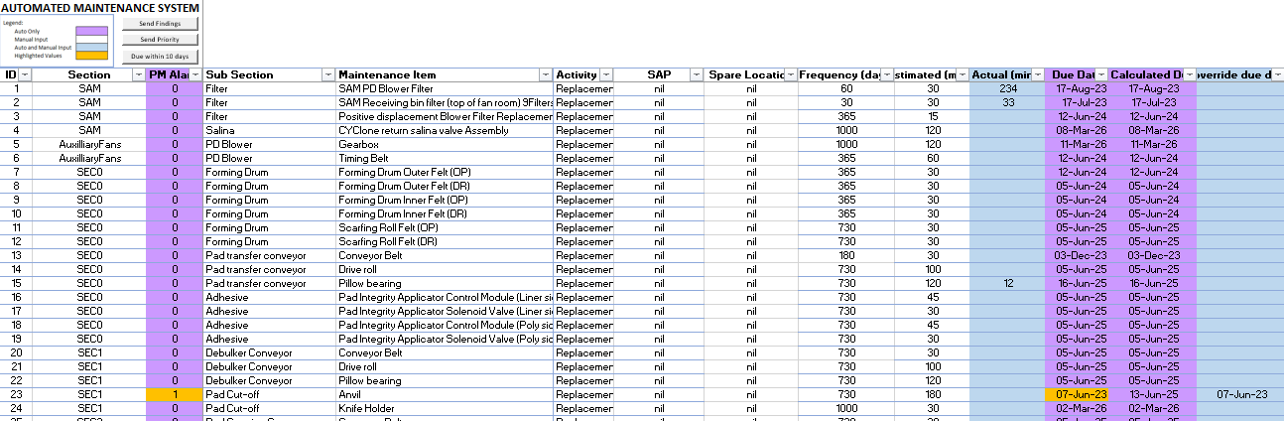



Database
Database Auto Update from UI inputs
Date done
Done by who
Dates done historical data
Findings and Suggestions
Due date
2. Auto Daily Email Notifications
Priority Items
Items with Findings and Suggestions from the crew
Parts replacement due within 10 days
3. User Controllable Items after data review
Override Due date
Select Priority items
Manual Sending of updates (email)

Slide 4
Process Flow:
Start
From UI, User will click on a button
Is it Red?
No
Blank List will appear
Yes
List of pending items for a particular section will appear
Findings and Suggestions Entered?
No
User will select the item row
No
Name entered?
Item condition ok until next due date?
Yes
Database will auto update
User will be required to enter his name
Yes
Exit

